Slide 1

SEARCH & SEIZURE
TRAINING
Guam Department of Education
Zoom Presentation
Presented by: SSSD & Legal Counsel
SPRING BREAK - SY 24-25

Slide 2
OBJECTIVES
All participants will complete annual training and be authorized to conduct searches and seizures.
Training ONLY counts for SY24-25 and will need to complete over the Summer for SY25-26.
All participants will understand the philosophy behind searches and seizures involving students in the Guam Department of Education.
All participants will understand and be able to apply the Tactics, Techniques, and Procedures (TTPs) when conducting searches and seizures.

Slide 3
AGENDA
Student Support Services Division Administrator, Christopher Anderson
      Review of Board Policy 407
      SOP 1200-010
      SOP 1200-002
II. DOE Legal Counsel,
Matt Wolff
      Legal Theory & Application
III. Tactics, Techniques & Procedures – SAO Demonstration
A. Verbal Commands and Escort Procedures
B. Pat down
C. Bag/Jacket Search
*Participants, please sign in using the link provided*

Slide 4
BOARD POLICY 407
Adopted on December 17, 2013.
Gives the authority to the Superintendent to establish and implement Standard Operating Procedures (SOP) for student searches and seizures.
These SOPs govern the type and number of searches and seizures conducted on each campus.
Board Policy 407 requires that searches and seizures of students must be reported to the Guam Board of Education annually.

Slide 5
Standard Operating Procedure 1200-010: Search and Seizure
Involves Staff Training in Student Searches and Seizures.
  As of date: January 1, 2013, the DSESCL shall develop and implement a training program on search and seizure that shall include, at a minimum, topics required by applicable law, regulation, or GDOE Board Policy. Today’s Sign in Sheet will be uploaded to Search and Seizure page on SSSD website.
  Personnel are identified in the summer in order to complete annual training requirements.

Slide 6
SOP: 1200-010 (continued)
  Employees are not authorized to conduct a search and seizure until after they have successfully completed annual training.
  Administrators do not have to physically conduct the search, but they must be trained and physically present when a search/seizure is conducted.

Slide 7
SOP 1200-002: Student Search and Seizures
Requirements and Responsibility:
As of date: March 9, 2023,School Administrators shall be held accountable for conducting student searches and seizures. School administrators are responsible for data and management oversight of student searches and seizures.
GDOE is responsible for annually reporting to the BOARD
Deputy Superintendent of Educational Support and Community Learning will monitor Internal Control of SOP 1200-002. (SSSD will post on search & seizure site all who completed training.)

Slide 8
SOP 1200-002 (Continued)
There are 3 types of searches:
  Blanket: conducted in the entire student body to ensure health, safety, and well being of all DOE student body.
  Random Searches: Parking Lots and school lockers may be conducted according to procedures developed by the Superintendent. (i.e. Every 5th car or locker, or odd or even sequence)
  Reasonable Suspicion: a particular group or students may be in possession of contraband.

Slide 9
SOP 1200-002 (Continued)
Step by Step Protocol for Conducting Student Searches:
  Always have another person with you when you search a student. The gender of the person searching should be the same as the student being searched (note: Not absolute).
  Identify correct student to search. Serious substantive due process issues may arise out of searching wrong student.
  Escort student to be searched directly to the office or other private location.
  Have the student walk in front of you and watch their hands. If a student is suspected of having a weapon or drugs (secure the bag), student may try to discard item if opportunity arises.

Slide 10
SOP 1200-002 (Continued)
Step by Step Protocol for Conducting Student Searches:
  Direct student to remove excess clothing (jackets, sweaters, etc.) and empty contents of their pockets by turning them inside out.
  Remember the reasonableness of the search.
  Through process tell student what you are going to do and why. Talk to student as you search them and their possessions. This helps alleviate anxiety associated with being searched.
  Seize illegal items that violates any school rules or laws.

Slide 11
SOP 1200-002 (Continued)
GDOE SOP 1200-002, Section IV(B)(2) Conducting a Student Search Using a Handheld Electronic Metal Detector/Wand.
  Must be either based on reasonable suspicion or pursuant to a blanket administrative search.
  Blanket administrative search is necessary for the safety of the entire school community. Before a blanket administrative search is conducted, the school shall notify the Superintendent of Education. Section IV(A)(3).
  School shall maintain annual records of all searches and seizures conducted on school.

Slide 12
GOOGLE SURVEY
Board Policy 407 requires that the Superintendent of Education report annually on the disposition of searches and seizures.
Survey is designed for schools to report the searches/seizures conducted.
Each time a search is conducted, school administrators shall complete the survey.
For example, if five (5) reasonable searches are conducted in one day, there shall be five separate survey entries. This allows the department to capture the total number and type of searches conducted. If a canine sweep is done at your school site, this shall be logged as a blanket search.
Canine searches shall be logged as a blanket search.
At the end of the year, the compilation of data will be submitted to the GEB for review.
As a reminder, all schools are required to maintain a manual log/record of all searches conducted and list of all items confiscated in addition to using the Search and Seizure Google Survey.
Notes:
NOTE-

Slide 13
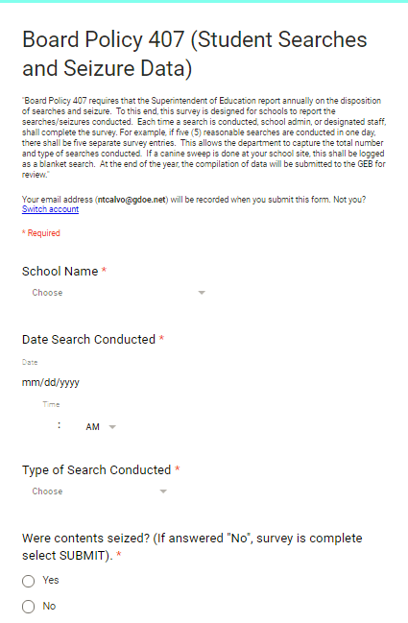
GOOGLE SURVEY
The Google Survey has been updated and will be used for the upcoming school year.
Link:
https://docs.google.com/forms/d/1YvqcyyniVq5_cXJW1dsIdjQx7G0Al_K6p4e3jv93xOg/edit

Slide 14
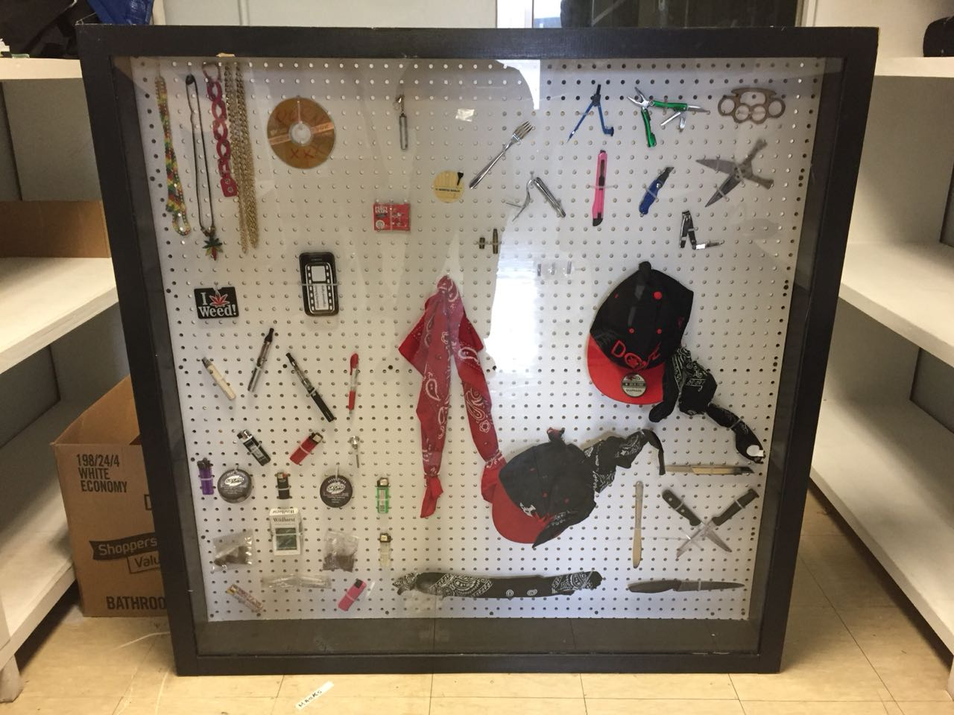
Data Collection SY24-25
        Type of Search:
        Reasonable Suspicion: 124
        Seizure without Search: 33
        Random Search: 10
        Blanket Search: 9
        Seized Items:
        Non-electronic: 0
        Electronic (Vape/Mod): 170
        Contraband: 92
        (Bandana, permanent markers)
        Weapons: (knife) 22
        Drugs: (Marijuana, inhalant) 13
      Combustibles: (Lighter) 9
All school are authorized by former DESCL, E. Cruz to discard all electronic
nicotine devices by disposing them in the trash bin.

Slide 15
Check for understanding
10 question Quiz

Slide 16
True or False
All GDOE employees who have completed annual training are authorized to conduct searches and seizures.
  TRUE
Board Policy 407 gives authority to Christopher Anderson to establish and implement Standard Operating Procedures (SOP) for student searches and seizures.
  FALSE (Superintendent)
Board Policy 407 DOES NOT require for all searches and seizures conducted to be reported to the Guam Education Board annually.
  FALSE
SOP 1200-02 indicates three (3) types of searches: Blanket, Random, and Reasonable Suspicion. A Blanket Search is when the entire school population is searched to ensure health, safety, and well-being.
  TRUE
  A Random search is when student lockers and parking lots, and/or non-personal property are searched using a prescribed method ((every 5th locker in row). NOTE: Personal property (bags, purses, etc.) cannot be searched.
    TRUE

Slide 17
True or False
A Reasonable Search is when a particular group or students may be in possession of contraband and need to be searched.
  TRUE
When school officials have reasonable suspicion and need to search student’s personal belongings – it’s best NOT to have them remove their jacket, hat, purse, etc., or give a student the option to “come clean.”
  FALSE : best to have them remove and option to “come clean.”
The Superintendent MUST be present during a search.
  FALSE (School Administrator)
It is best to be alone when conducting a search.
  FALSE (Always with another person and school administrator)
Search all pockets, seams, and potential areas of a bag or jacket that may be possibly tampered with to hide possible contraband is a good procedure to follow.
  True
  BONUS: “SOP 1200-002” authorizes schools to use hand held electronic wands during random searches.
  FALSE (only reasonable & blank searches)

Slide 18
THE FOLLOWING DOCUMENTS CAN BE ACCESSED ON THE SSSD WEBSITE:
Board Policy 407 (Search & Seizure)
SOP 1200-010 (Staff Training Student Search & Seizure)
SOP 1200-002 (Student Searches & Seizures)
SOP 1200-003 (Cell Phone Usage)
PPT -Theory and Philosophy Behind Search/Seizure
PPT- Tactics, Techniques & Procedures (SAOs)
*Documents may be accessed at the following link:
https://www.gdoe.net/District/Department/9-Student-Support-Services-SSSD/1603-Search-and-Seizure.html

Slide 19

QUESTIONS, COMMENTS OR CONCERNS???

Slide 20

SEARCH AND SEIZURE TRAINING
Legal Theory and Application

Slide 21

Presentation Topics:
US Constitution Fourth Amendment
Consensual vs. Nonconsensual Searches
Reasonable Suspicion
Random Searches
Blanket Searches
Questions/Answers

Slide 22
U.S. Constitution: Fourth Amendment
What does it protect?
The right of the people to be secure in their persons, papers and effects, against unreasonable searches and seizures, shall not be violated, and no Warrants shall issue, but upon probable cause, supported by Oath or affirmation, and particularly describing the place to be searched and persons or things to be seized.
The Fourth Amendment protects an individual’s justified expectation of privacy against unreasonable government intrusions. Terry v. Ohio, 392 U.S. 1, 9 (1967).
What is allowed?
The Fourth Amendment does not, however, prohibit all forms of government intrusion. Reasonable intrusions are allowed when legitimate governmental interests are served.
Notes:
Give a brief overview of the presentation. Describe the major focus of the presentation and why it is important.
Introduce each of the major topics.
To provide a road map for the audience, you can repeat this Overview slide throughout the presentation, highlighting the particular topic you will discuss next.

Slide 23
U.S. Constitution: Fourth Amendment
Searches: may be defined as a government official’s unreasonable physical touching of a person or physical entry into a private area or physical handling of papers and effects.
Seizures: may be defined as governmental interference with an individual’s liberty or possessory interest, including physically taking tangible property, as well as taking intangibles such as private conversations.
Notes:
Give a brief overview of the presentation. Describe the major focus of the presentation and why it is important.
Introduce each of the major topics.
To provide a road map for the audience, you can repeat this Overview slide throughout the presentation, highlighting the particular topic you will discuss next.

Slide 24
U.S. Supreme Court
New Jersey v. T.L.O., 496 U.S. 325 (1985).
The U.S. Supreme Court held:
  Public school students have a legitimate expectation of privacy and the prohibition on unreasonable searches and seizures applies to searches and seizures by public school officials.
  Public school officials do not need search warrants or probable cause before searching students under their authority.
  Ct reasoned requiring school officials to obtain a warrant or probable cause would unduly hamper schools in their efforts to maintain order and discipline and interfere with effectiveness as educators.
  Ct concluded a reduced standard was justified for searches and seizures in schools because of the substantial government interest in maintaining a proper learning environment for educating children
  Student searches must be reasonable under all the circumstances to be lawful.
Notes:
Give a brief overview of the presentation. Describe the major focus of the presentation and why it is important.
Introduce each of the major topics.
To provide a road map for the audience, you can repeat this Overview slide throughout the presentation, highlighting the particular topic you will discuss next.

Slide 25

What is reasonable under all the circumstances?
Two-fold inquiry:
1) Was the action was justified at its inception?
-Are there reasonable grounds for suspecting that the search will turn up evidence that the student has violated the law or school rules?
2) Was the search conducted reasonably related in scope to the circumstances which justified the interference in the first place?
-Are the measures adopted reasonably related to the objectives of the search?
-Is the search excessively intrusive in light of the age and sex of the student and the nature of the infraction?

Slide 26
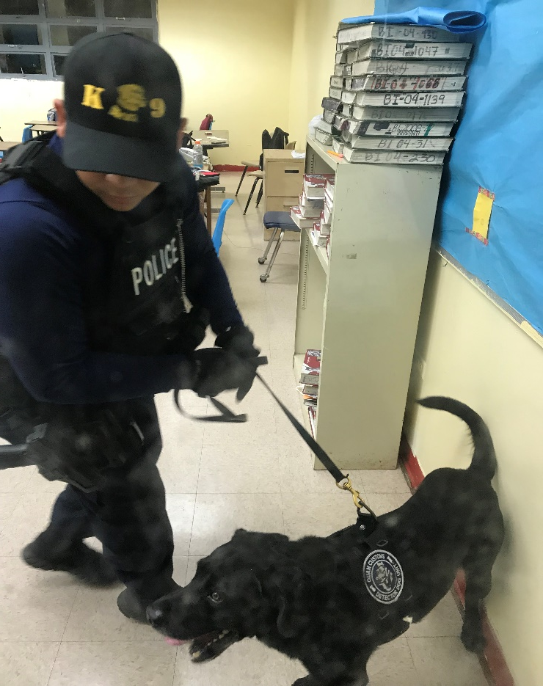
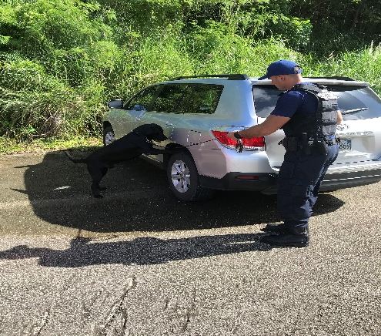
GDOE SOP1200-002
Why?
Contraband has been and is still present in our schools. SOP 1200-002 is a tool to combat presence of weapons, drugs, and other items (cigarettes, sexual devices, pipes for smoking, etc.)
What?
Authorizes different searches
  Consensual vs. Nonconsensual
  Reasonable Searches
  Random Searches
  Blanket Searches
How?
SOP1200-002 provides steps to search

Slide 27
Consensual Searches
Consent must be voluntary and not the result of coercion, undue influence or threat and without the threat of punishment.
Example: student told to empty pockets or face discipline has not consented to search, even if they comply with request. Consent determined from totality of instance.
Must have authority to give consent. Does not have to be in writing, but that is preferable.
Refusal to consent does not give rise to reasonable suspicion to believe student is hiding something.
continuation……..

Slide 28
Consensual Searches
Recommended that student be advised what school official is searching for prior to asking for consent to search.
Consent to search a generalized area is a consent to search any items found in that area.
Talk to the student and if possible get permission, preferably in writing.

Slide 29
Non-Consensual Searches
Searches of a Student’s Personal Belongings:
When school officials have a reasonable suspicion to believe a student has contraband or evidence of a violation in their jacket or other outer clothing, backpack, purse, or other bag, the student should be asked to put the object down and remove any outer clothing so that these objects can be searched without physically touching the student’s person. It is especially important to give the student the option to “come clean” with the object being sought without touching the student because searches of the student’s person are particularly invasive.
A non-consensual search requires reasonable suspicion…..

Slide 30
Reasonable Suspicion
Requirements for school officials differs from law enforcement who generally require a search warrant and probable cause.
Reasonable suspicion means a well-founded suspicion based on objective facts that can be articulated. More than just a hunch.
School environment (also school-sponsored activities): a search is permissible where a school official has reasonable suspicion based on the totality of the circumstances for suspecting that the search will reveal evidence that the student has violated a law, district policy, or rules of the school. Reasonable suspicion based on an individualized suspicion of wrongdoing.
continuation…….

Slide 31
Reasonable Suspicion
Supreme Ct Example:
Teacher observed two female students smoking in bathroom (violation of school policy). Two students were taken to the office and questioned by the vice-principal. One student admitted to smoking, but the other denied. The vice-principal took the student that denied smoking into an office and asked to search her purse. Search revealed cigarettes and rolling papers, which led to a search for marijuana.
Held: There was reasonable suspicion to search purse based on teacher’s observations of student smoking and student denied smoking because it was reasonable to infer student may have cigarettes in her purse.
Held: There was reasonable suspicion to continue searching student’s purse for marijuana because of the presence of the rolling papers.
NOTE: Must have an administrator present at time of reasonable suspicion search!

Slide 32
Random Searches
Random searches are part of operational functions of schools within GDOE. Random searches authorized when searching school lockers or areas that are not personal property of a student (back packs, purses, etc.) and may be conducted according to procedures developed by the Superintendent. Students and parents shall be provided notice of the possibility that random searches my be conducted for student safety.
Requirements:
Does not require Reasonable suspicion. However, a process must be followed to ensure search is random and not targeting individual student.
School administrators shall be responsible for fashion and manner searches are conducted. Random searches may be conducted as deemed necessary.
Random Search Methods:
Odd and even sequence such as last number of a locker.
Other randomly assigned number, i.e. every 5th locker with be searched.

Slide 33
Blanket Administrative Searches
Purpose: Blanket Administrative searches are necessary to ensure the health, safety, and well-being of all GDOE’s student body. They are not designed to catch offenders, but rather to prevent students from bringing or keeping dangerous weapons, drugs, alcohol, and other prohibited items on school grounds. Therefore, no individualized suspicion for this search.
Intent: To send a clear message to students that certain types of behavior will not be tolerated.
School Administrators will notify the Superintendent of Education when a search of the entire student body is conducted.
Examples: Use of drug or weapon detection dogs.

Slide 34
Cell Phones
SOP 1200-02 Effectively Updated February 2023.
A school may search a student’s cell phone/electronic device if the school has reasonable suspicion that the student violated school rules or Guam law and search is justified in its inception and permissible in its scope.
Examples:
-violation of a school’s no cellular phone policy does not justify reading text messages contained in the phone
-a search of text messages may be reasonable if there is reasonable suspicion that text messages would reveal the violation of a law or school policy

Slide 35
Cell Phones Part 2
GDOE SOP 1200-002, Section IV(B)(3) Search of Student Cell Phone/Electronic Devise:
  Requires reasonable suspicion of a violation of school rules, Guam or Federal law, and evidence of the violation can be found in the cellular phone/electronic device.
  Caution to keep the search reasonable in its scope.

Slide 36
Handheld Electronic Metal Detector/Wand
GDOE SOP 1200-002, Section IV(B)(2) Conducting a Student Search Using a Handheld Electronic Metal Detector/Wand.
  Must be either based on reasonable suspicion or pursuant to a blanket administrative search.
  Blanket administrative search is necessary for the safety of the entire school community. Before a blanket administrative search is conducted, the school shall notify the Superintendent of Education. Section IV(A)(3).
  School shall maintain annual records of all searches and seizures conducted on school.

Slide 37
School Attendance Officer Team
School Attendance Officer II - Supervisor Sherry Sanchez
SAO II Dean Blas
SAO II Frankie Concepcion
SAO II Andre Morales
SAO II Claire Arceo
SAO II Ichiro Kikuo
SAO II Eloise Munoz
SAO II Jerry Grantham
SAO II T’Anna Dela Cruz
SAO II Reedwin Edwin
SAO II Britany Salas

Slide 38
TACTICS, TECHNIQUES & PROCEDURES
Verbal Commands/Escorting Procedures
Pat Down
Bag Search

Slide 39
VERBAL COMMANDS & ESCORTING PROCEDURES
In a perfect setting, a proper escort should consist of two adults to one student. We all know that this is not always the case, and that in most situations, students may be escorted by one adult. However, for the purpose of this training, we will demonstrate verbal commands and escorting procedures in pairs.

Slide 40
VERBAL COMMANDS & ESCORTING PROCEDURES
When approaching a student, be as courteous and respectful as possible, in hopes that it will be reciprocated. In most cases, students comply when approached in a positive manner.
Typically, the student will question you about why they are being asked to go to the office or called out. Try to keep the information minimal and inform the student that you don’t know or are unsure of why they’re being called to the office, but at the same time, ensure them that you will be with them to find out. Try to ease the student’s anxiety by remaining calm and encouraging.

Slide 41
VERBAL COMMANDS & ESCORTING PROCEDURES
1. Individuals providing the escorts must maintain visual and verbal contact with the student(s) being escorted at all times.

Slide 42
VERBAL COMMANDS & ESCORTING PROCEDURES
2. Once you begin the escort, while focusing on external threats, always pay close attention to the student; what he/she is doing, and if he/she is concentrating on anything specific that may look suspicious in nature.

Slide 43
VERBAL COMMANDS & ESCORTING PROCEDURES
3. Watch for suspicious actions while escorting the student to the main office. Remember that you have to be watching to see a problem.

Slide 44
VERBAL COMMANDS & ESCORTING PROCEDURES
4. Stay close enough to the student so that you are able to react if necessary. Remember to walk behind the student and adopt a “hands on” approach when escorting, in order to avoid attempts by the student assault you, flee from you, or fall down ( which can lead to injuries).

Slide 45
VERBAL COMMANDS & ESCORTING PROCEDURES
5. If the student discards an item while being escorted, immediately stop the escort and inform the front escort to maintain control of the student, while the rear escort retrieves the contraband. Once the contraband is retrieved, immediately proceed to the main office and report it to the school administrator.
Thank the student for their cooperation.

Slide 46
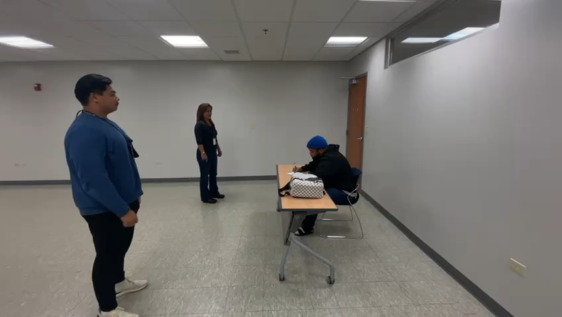

Slide 47
PAT DOWN
An administrator must be present when conducting a search.
The rule of thumb is: the person doing the search will be the same gender as the student being searched.
Conduct the search in an area that is discreet enough to protect the student’s privacy and integrity.

Slide 48
PAT DOWN
Once you are behind the person, you want to limit the student’s mobility.
To do that, you have the student widen their stance.
This part of the technique is also used to offset a disparity in height between a taller student and a shorter staff. This also makes it easier to maintain control of the student.

Slide 49
PAT DOWN
To initiate movement from a widened stance (such as lunging forward or turning around preparatory to attack) the human body will instinctively move one or both legs toward its centerline.
This movement creates more time for you to perceive resistance and react appropriately.
In combative situations, fractions of a second can mean the difference between an advantage and a disadvantage.

Slide 50
PAT DOWN
Ensure that you maintain visibility of the student’s hands as well as their body language and verbal cues.
Of the personal weapons aggressors can use to hurt you, their hands should be your greatest concern.
A student’s hands can be used to strike, grab, choke and manipulate weapons.

Slide 51
PAT DOWN
Stay vigilant and be ready to react should the student become aggressive or uncooperative.
Be mindful that the student is more than likely in an uncomfortable situation and they probably feel as if their personal space is being violated.
Remain courteous and respectful of their feelings.
Thank the student for their cooperation.

Slide 52
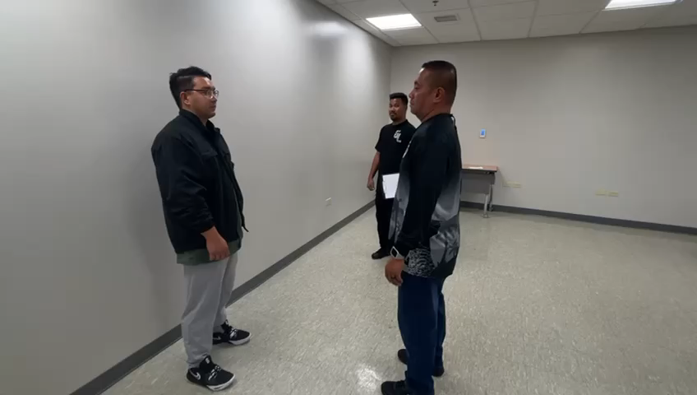

Slide 53
BAG SEARCH
An administrator must be present during a bag search, and can be the scriber to document the contraband that is found.
ALL searches must be conducted in a private place and or location
ALL searches must be kept discreet, ensuring to protect the integrity of the student

Slide 54
BAG SEARCH
To encourage cooperation:
Give the student the opportunity to surrender the contraband before starting the search. Ask the student if he/she has any items in their possession that are against the school’s rules or the law.

Slide 55
BAG SEARCH
2. Always tell the student(s) what you are going to do and why you are doing it.
Talk to the student as you search them, their bags or other possessions. This helps to alleviate any anxiety associated with being searched.

Slide 56
BAG SEARCH
3. Thoroughly examine the item(s) being searched.
Flip through pages of books or notebooks and then turn over and shake.
Check for pens or markers that could be converted to weapons or pipes used for drugs.
Open all containers and coin pouches. (i.e. pill bottles, crazy glue containers, etc)
Ensure you look for secret and/or hidden pockets or compartments.

Slide 57
BAG SEARCH
4. The administrator or observer should watch the student for any signs of unusual behaviors.
5. If any contraband is found, confiscate and follow protocols set by Board Policy (BP 407) & Standard Operating Procedures (SOP 120-010).

Slide 58
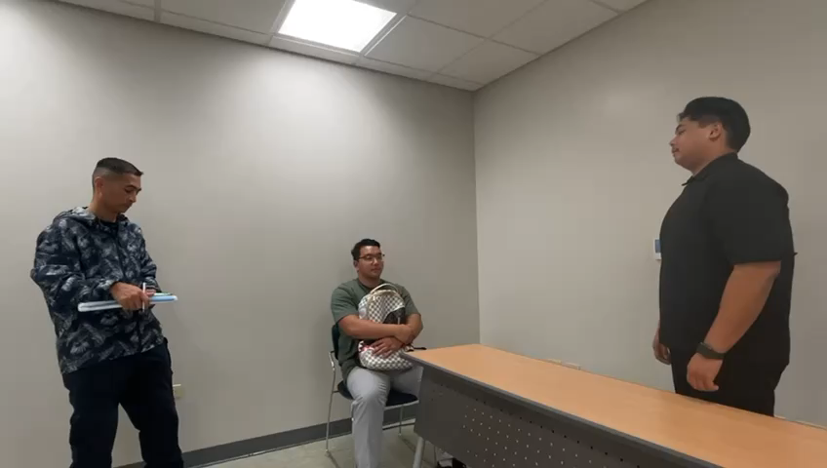

Slide 59

QUESTIONS?

